Slide 1
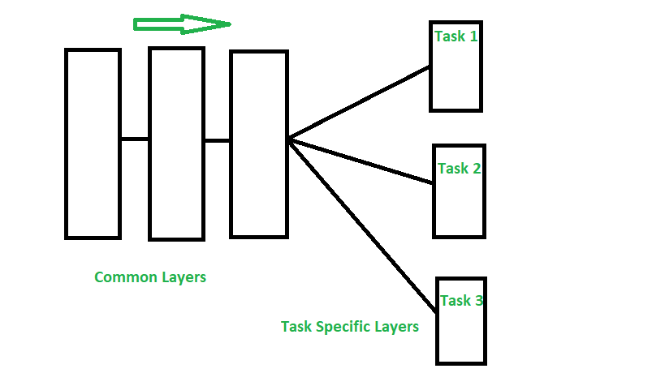
Custom Image Classification with CNN using OpenCV in Python
Project Presentation

Slide 2
Team Members
Name | ID
Abdelrhman Mohamed Abdelhady Hodib | 2022513643
Ahmed Mostafa AbdelRahman | 20221372883
Mazen Gaber Mahmoud | 20221372110

Slide 3
Idea
Project Title: Custom Animal Type and Color Classification
Project Goal: Develop an accurate CNN model capable of classifying images into cat or dog categories and identifying their colors white or black with high precision and recall.

Slide 4


Data Creation
400 images
400 images
400 images
400 images

Slide 5
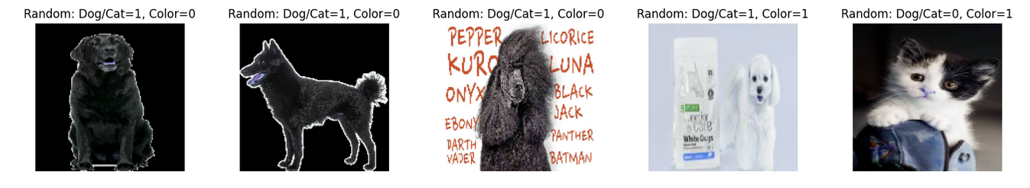
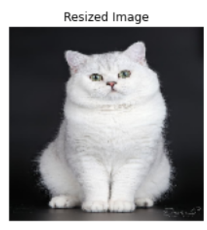
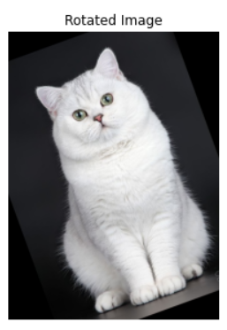
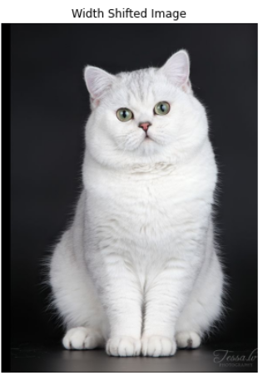
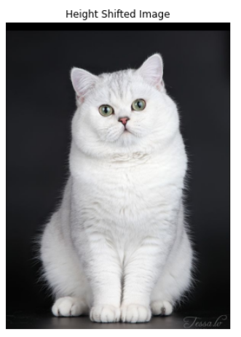
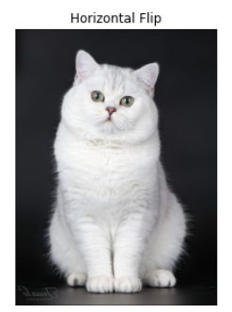
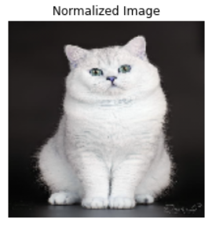
Data Preprocessing
Data Loading and Structuring
Data resizing, normalization, augmentation

Slide 6

Data Augmentation

Slide 7
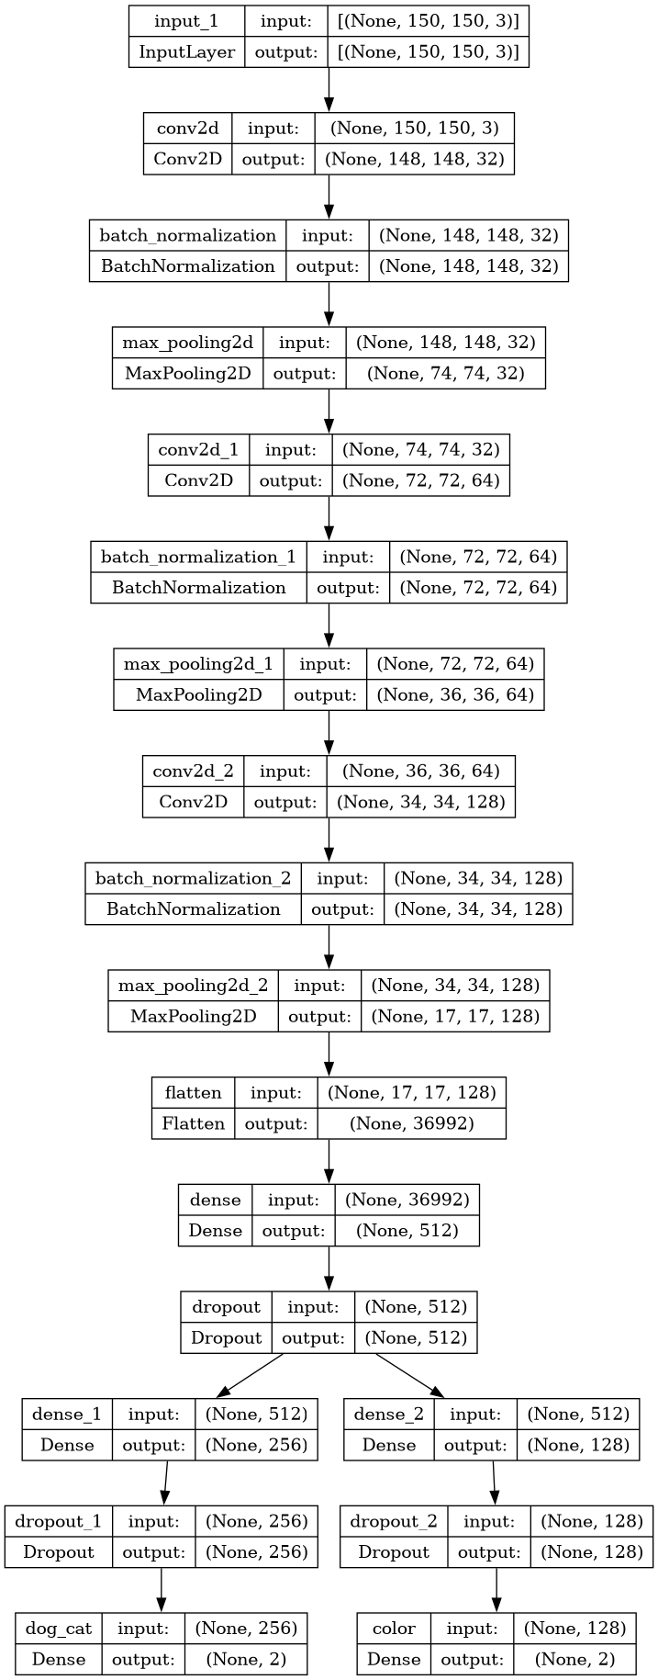
CNN Model

Slide 8
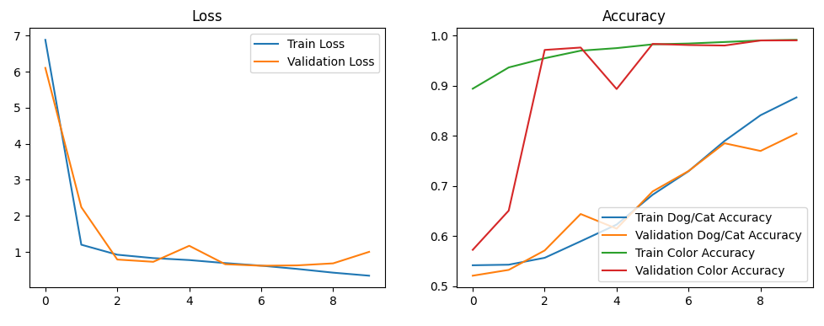

Results
Training and validation Results
Testing Results

Slide 9
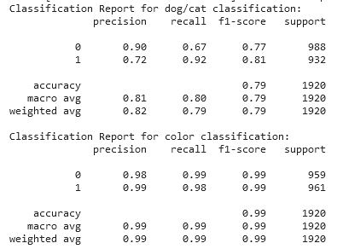
Results

Slide 10
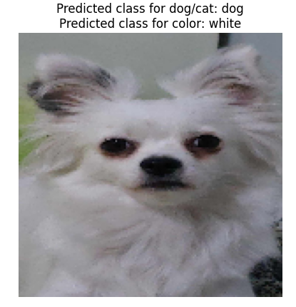
Testing

Slide 11
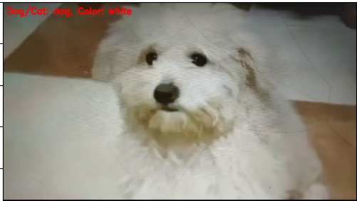
Testing

